Slide 1
Predicting Prediabetes/Diabetes from Patient Health Indicators
Neil John F. Catapang
AI 201 Mini Project
Notes:
Good evening, everyone. My mini project is about predicting prediabetes/diabetes from patient health indicators.

Slide 2
Table of Contents
01
Background
04
Results & Discussion
02
Objectives
05
Conclusion
Diabetes
Diabetes Diagnosis
ML Classifiers
SMOTE vs. Under-sampling
ANN vs. RF vs. XGBoost
Feature Importance
Prediction of diabetes from health indicators
Overall results
03
Methodology
06
Recommendations
Dataset
Pre-processing
Classifiers
Classifier improvements

Slide 3
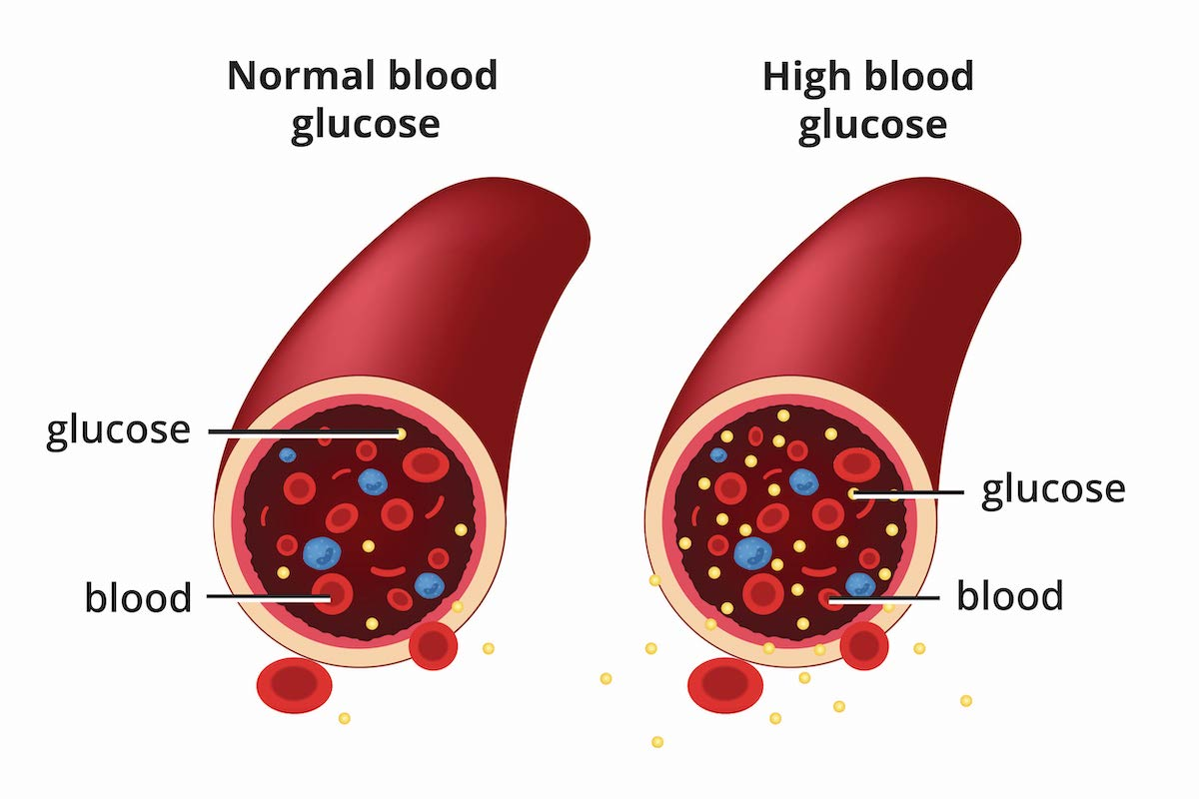
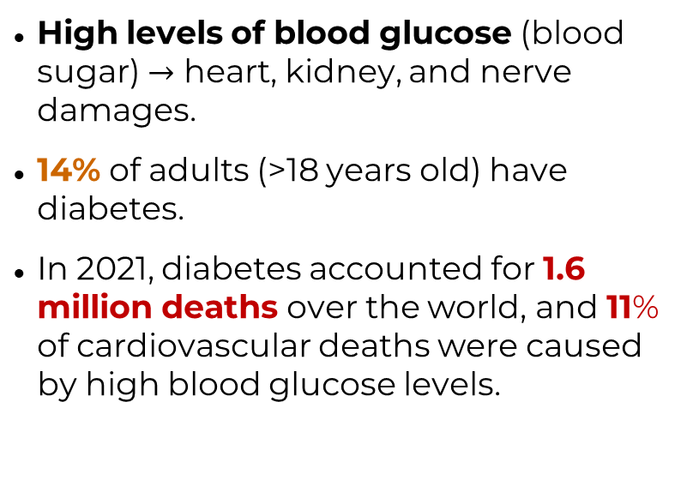
Overview of diabetes*
Background
01
High levels of blood glucose (blood sugar) $→$ heart, kidney, and nerve damages.
14% of adults (>18 years old) have diabetes.
In 2021, diabetes accounted for 1.6 million deaths over the world, and 11% of cardiovascular deaths were caused by high blood glucose levels.
Figure 1. Comparison of normal and high blood glucose levels due to diabetes.
Source: National Institute of Health, 2023
*Source: World Health Organization, 2024
Notes:
Diabetes is characterized by high levels of blood glucose (blood sugar) which progresses into serious complications such as heart, kidney, and nerve damages.
Diabetes is a very prevalent disease around the world. In fact, 14% of adults have diabetes. Also, this disease accounts for 1.6 million deaths in 2021, as well as 11% of all total cardiovascular deaths.
Due to its prevalence and severity, it is necessary that healthcare institutions worldwide focus on formulation of effective diagnosis and management of diabetes.

Slide 4
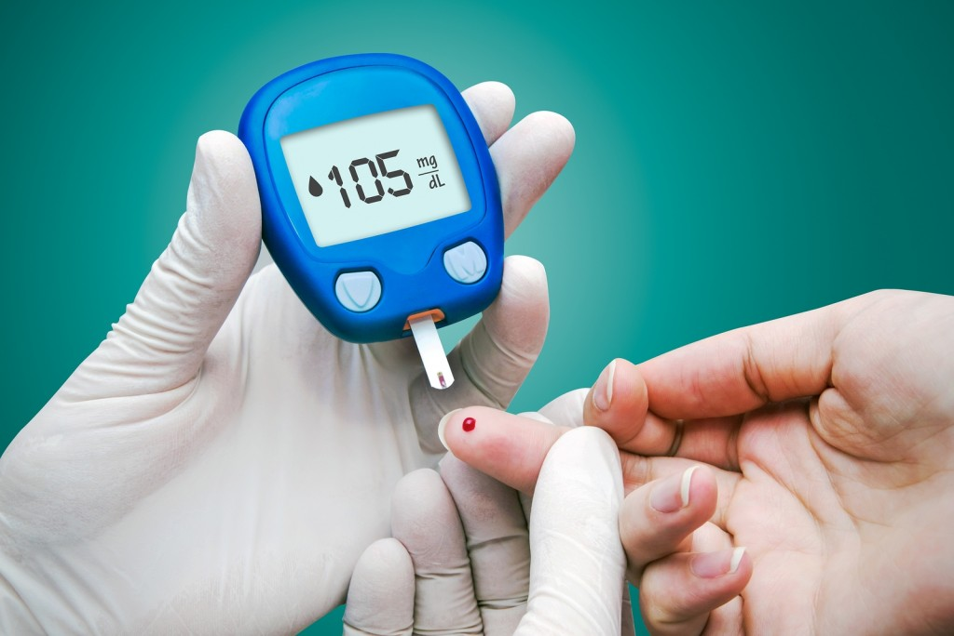
Challenges in diagnosis
Background
01
The usual diabetes tests (A1C test and Fasting Blood Sugar Test) are expensive, inconvenient, and not very sensitive to prediabetes cases.
Using machine learning (ML) algorithms can supplement traditional diagnostic methods to ensure proper detection of diabetes cases.
These algorithms can process large amounts of data (e.g., patient data) in a short amount of time.
Figure 2. Diabetes testing using glucometer.
Source: Advanced Diabetes Centre, 2015.
Notes:
For these reasons, it is important for health care units to properly detect cases of diabetes as early as possible to prevent progression to serious complications.
However, the usual diabetes tests (A1C test and Fasting Blood Sugar Test) are expensive, inconvenient, and not very sensitive to prediabetes cases. These reasons can possibly discourage people with diabetes to proceed with detection and treatment.
A potential solution is the use of machine learning algorithms, which can supplement traditional diagnostic methods to ensure proper detection of diabetes cases. These are preferred since these can process large amounts of data (e.g., patient data) in a short amount of time, which allows quick predictions for screening purposes.
Thus, this mini project aimed to develop machine learning algorithms to predict pre-diabetic/diabetic cases using the available worldwide patient data.

Slide 5
Objectives
Objectives
02
To develop artificial neural networks, random forest classifiers, and XGBoost classifiers for prediction of prediabetes/diabetes cases from patient health indicators,
To balance the CDC Diabetes Health Indicators Dataset by random under-sampling and synthetic minority over-sampling (SMOTE),
To determine the most important features for prediction of prediabetes/diabetes cases, and
To evaluate and compare the performance of the classifiers.
Notes:
The objectives of this study are:

Slide 6
Dataset
Methodology
03
CDC Diabetes Health Indicators dataset*
Cleaned BRFSS 2015 dataset of CDC
253,680 instances
21 features (lifestyle factors)
Binary (0 – no diabetes, 1 – prediabetic/diabetic)
Imbalanced (86:14 ratio)
Dataset balancing
Random under-sampling
Synthetic Minority Over-sampling Technique (SMOTE)
Data preprocessing: Standard Scaler
Train-test split: 20% test
*Source: https://archive.ics.uci.edu/dataset/891/cdc+diabetes+health+indicators
Notes:
The dataset used in this study is the CDC Diabetes Health Indicators dataset obtained from UCI machine learning repository. It is a cleaned dataset of CDC’s Behavioral Risk Factor Surveillance System in 2015, and it contains 253,680 instances (Americans who participated in the survey) and 21 features. The prediabetic or diabetic class is a minority class, making this dataset highly imbalanced.
Thus, to balance the data, this study employed two techniques which are:
Random under-sampling, and
Synthetic Minority Over-sampling Technique (SMOTE)

Slide 7
Artificial Neural Network (ANN)
Methodology
03
Network of neurons (multilayer perceptrons) with non-linear activations.
Table 1. Hyperparameters used for the artificial neural network setup.
Library | Keras
Network Structure | 2 Hidden + 1 Output Layers
Hidden Layer 1 | 16, LeakyReLU(0.01)
Hidden Layer 2 | 16, LeakyReLU(0.01)
Output Layer | 1, Sigmoid
Optimizer | Adam(lr=0.001)
Regularization | L2 (ridge), 0.001
Callbacks | Early Stopping, Learning Rate Decay
Notes:
One of the classifiers used in this study is the artificial neural network or ANN. Table 1 shows the hyperparameters used for the artificial neural network setup.
It is a network with 2 hidden layers which uses LeakyReLU and an output layer which use the logistic function. Adam was selected as the optimizer, with an initial learning rate of 0.01. L2 regularization, early stopping, and learning rate decay were also used to prevent overfitting of the network on the training set.

Slide 8
Random Forest Classifier
Methodology
03
Ensemble method (bagging) using multiple decision trees.
Table 2. Random Forest hyperparameters tested using GridSearchCV.
Parameter | Values
‘n_estimators’ | 50 | 100 | 200
‘max_depth’ | None | 10 | 20
‘min_samples_split’ | 2 | 5 | 10
Cross-validation folds | 3
Scoring | ROC AUC
Notes:
The next classifier is the random forest classifier, which is an ensemble method which uses multiple decision trees as estimators. Scikit-learn library was used for building the random forest classifier.
The hyperparameters of the Random Forest classifier were tuned via GridSearchCV. The hyperparameters which were tuned were the number of estimators or decision trees, maximum depth of tree, and minimum samples required for node split. During hyperparameter tuning, the models were validated via 3-fold cross-validation using the ROC area under the curve.

Slide 9
XGBoost Classifier
Methodology
03
Ensemble method (tree boosting) using decision trees and gradient descent.
Table 3. XGBoost hyperparameters tested using GridSearchCV.
Parameter | Values
‘n_estimators’ | 50 | 100 |  | 200
‘learning_rate’ | 0.01 | 0.1 |  | 0.2
‘max_depth’ | 3 | 5 |  | 7
‘subsample’ | 0.8 |  | 1.0
‘colsample_bytree’ | 0.8 |  | 1.0
Cross-validation folds | 3
Scoring | ROC AUC
Notes:
The last classifier is the Extreme Gradient Boosting classifier or XGBoost, which is a tree boosting algorithm which uses gradient descent for minimizing errors. The xgboost library is used to build this classifier.
The hyperparameters of the XGBoost classifier were also tuned via GridSearchCV. The hyperparameters which were tuned were the number of decision trees, learning rate, maximum depth of tree, subsample or the fraction of training data used for training a decision tree, and colsample_bytree or fraction of features used for training a decision tree. During hyperparameter tuning, the models were validated via 3-fold cross-validation using the ROC area under the curve.

Slide 10
Feature Importance and Metrics
Methodology
03
Feature Importance
Score: Mean reduction in impurity (Gini importance)
Model: Random Forest on under-sampled dataset
Evaluation criteria
Accuracy
Sensitivity
Specificity
F1 Score
ROC-AUC
Learning curves (ANN)
Notes:
The most important features for prediction of diabetes cases were determined and sorted using the Gini importance. The random forest classifier fitted on the under-sampled training dataset was used to reveal the importances of features for predicting diabetes cases.
The performance metrics used to evaluate the models were accuracy, sensitivity, specificity, and F1 scores. The learning curves of ANNs were also used to validate the model.

Slide 11
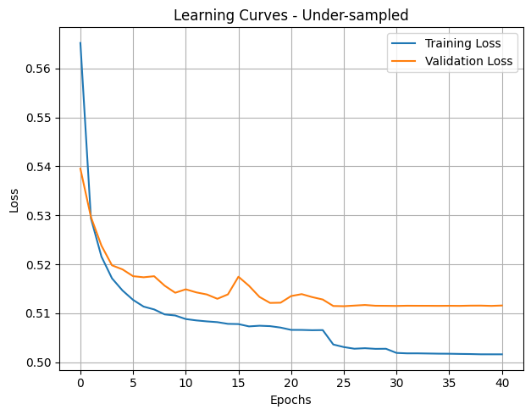
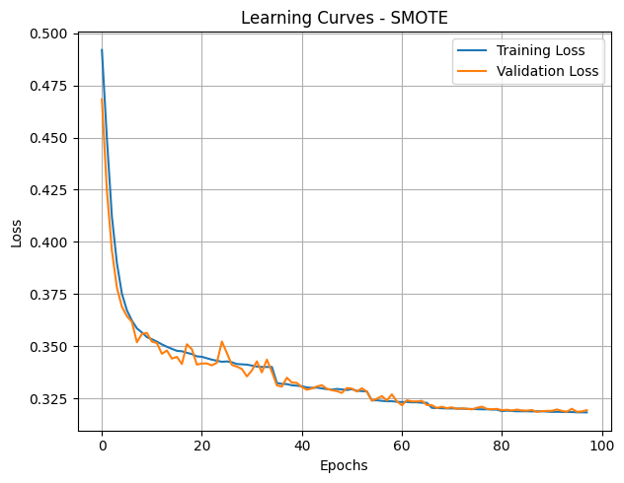
ANN Learning Curves
Results
04
Figure 3. Learning curves of ANN on under-sampled and over-sampled datasets.
Notes:
Figure 3 shows the learning curves of artificial neural networks trained on the undersampled and the oversampled dataset. No over-fitting was observed for both cases. However, higher loss values were found from the ANN trained on undersampled data. The synthetic data points generated by SMOTE may have improved the performance of the model.

Slide 12
Best Parameters (Ensembles)
Results
04
Table 4. Best hyperparameters found using GridSearchCV.
Parameter | Under-sampled | SMOTE
Random Forest Classifier
‘n_estimators’ | 200 | 200
‘max_depth’ | 10 | None
‘min_samples_split’ | 2 | 5
XGBoost Classifier
‘n_estimators’ | 200 | 200
‘learning_rate’ | 0.1 | 0.2
‘max_depth’ | 3 | 5
‘subsample’ | 0.8 | 1.0
‘colsample_bytree’ | 1.0 | 0.8
Notes:
For the random forest and xgboost classifiers, shown are the best parameters found using GridSearchCV. These parameters were then adopted and used to build classifiers for prediction and evaluation on the test set.

Slide 13
Classifier Performance
Results
04
Figure 4. Performance metrics for ANN, RF, and XGBoost classifiers on the balanced datasets.
Notes:
These are the overall performance results of three classifiers used for prediction and evaluation on undersampled and over-sampled datasets.
All classifiers performed better on the over-sampled or SMOTE dataset, which is possibly due to presence of additional synthetic samples for the minority class.
Focusing on performance results on the under-sampled dataset, all three classifiers have very similar performance. The three models performed on this dataset with 75% accuracy, 80% sensitivity, 70% specificity, and 76% F1 score.
On the other hand, in the over-sampled dataset, both random forest and xgboost performed better than ANN. Overall, the random forest classifier performed best among the three with 92% accuracy, 88% sensitivity, and 96% specificity, and 92% F1 score.

Slide 14
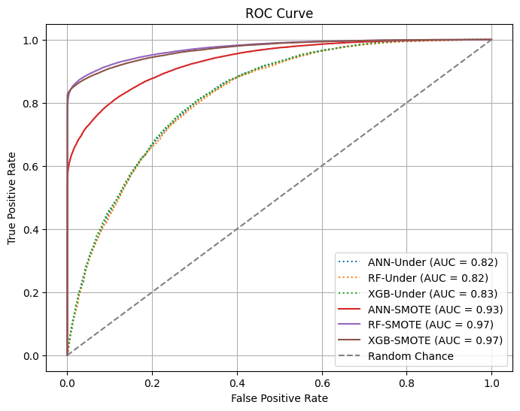
Classifier Performance
Results
04
Figure 5. Receiver operating characteristic curves for ANN, RF, and XGBoost models.

Slide 15
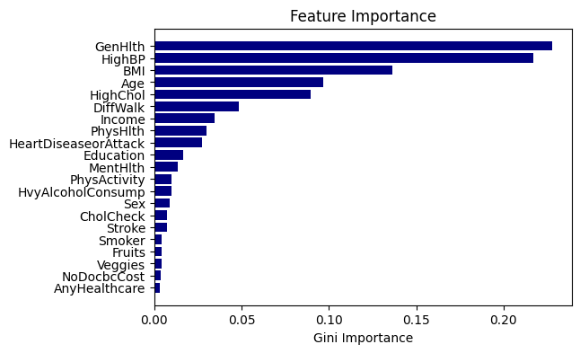
Feature Importance
Results
04
Figure 6. Feature importances for prediction of diabetes cases.
Notes:
The Gini importance of features were obtained from the random forest model on under-sampled dataset. The top 5 most important features found are:
General health status – survey score of participants on their over-all well-being
HighBP – if participants have high blood pressure
BMI – body mass index
Age
HighChol – if participants have high cholesterol levels

Slide 16
Feature Importance
Results
04
Risk factors* that contribute to developing type 2 diabetes include:
prediabetes
advanced age
high cholesterol
physical inactivity
high blood pressure
being overweight or obese
a history of gestational diabetes
a family history of type 2 diabetes
*Source: Government of Canada, 2023
Notes:
These findings were found to be in line with the known facts about diabetes, in which advance age, high cholesterol, high blood pressure, and obesity are considered risk factors that contribute to developing type 2 diabetes.

Slide 17
Conclusion
Conclusion
05
Artificial neural networks, random forest classifiers, and XGBoost classifiers were developed to predict prediabetes/diabetes cases from health indicators.
All three models performed comparably on under-sampled dataset with 75% accuracy, 81% sensitivity, 69% specificity, and 76% F1 score.
RF performed best on over-sampled dataset with 92% accuracy, 88% sensitivity, 96% specificity, and 92% F1 score.
The 5 most important features found were ‘GenHlth’, ‘HighBP’, ‘BMI’, ‘Age’, and ‘HighChol’.

Slide 18
Recommendations
Recommendations
06
Use of other parametric and non-parametric classifiers such as Naïve-Bayes Classifier and k-Nearest Neighbors Classifiers for comparison.
Increase the number of instances by augmenting the diabetes health indicators data from 2016-present.

Slide 19
References
Did you test yourself for Diabetes? - Advanced Diabetes Centre. (2016, January 25). Advanced Diabetes Centre. http://advanceddiabetescentre.com/blog/diabetes/did-you-test-yourself-for-diabetes/
Public Health Agency of Canada. (2023, December 28). Diabetes: Prevention and risk factors. Canada.ca. https://www.canada.ca/en/public-health/services/chronic-diseases/diabetes/prevention-risk-factors.html
What Is Diabetes? (2024, October 4). National Institute of Diabetes and Digestive and Kidney Diseases. https://www.niddk.nih.gov/health-information/diabetes/overview/what-is-diabetes
World Health Organization: WHO & World Health Organization: WHO. (2024, November 14). Diabetes. https://www.who.int/news-room/fact-sheets/detail/diabetes

